Slide 1
INTRODUCTION TO LINEAR ALGEBRA AND PROGRAMMING MT-104

Slide 2
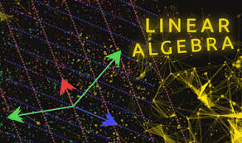
INTRODUCTION TO LINEAR ALGEBRA
Any equation that give straight line, when
plotted on a graph is called linear equation
Linear algebra is the branch of mathematics
Concerning linear equations such as linear functions
and their representations in vector spaces and
through matrices.

Slide 3
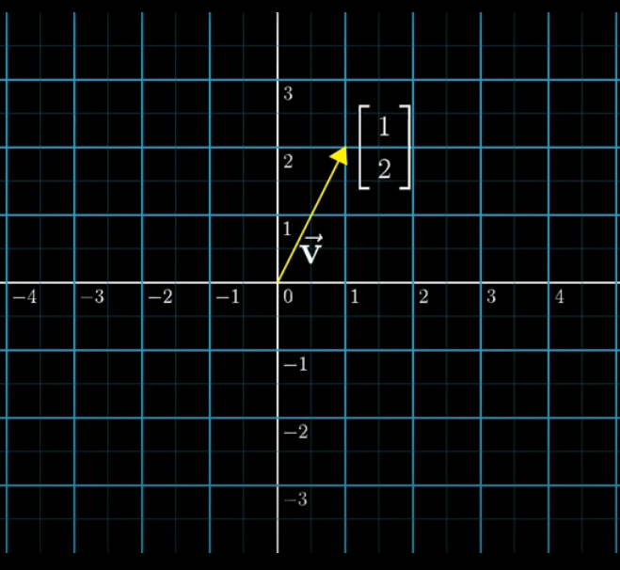
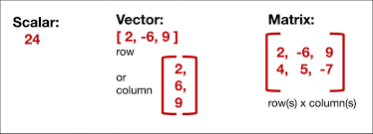
VECTORS: A vector is a list of numbers (can be in a row or column)

Slide 4
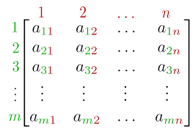
MATRICES:
MATRIX:
A matrix is a rectangular array of numbers, symbols, or expressions, arranged in rows and columns.
e.g.
This is a matrix with m rows and n column so the order of this matrix is m*n.

Slide 5
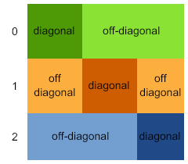
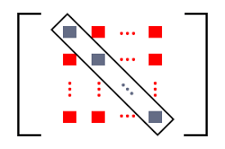
DIAGONAL AND OFF-DIAGONAL ELEMENTS:
In a matrix basically there are two elements,
first one is diagonal element and another one
is off-diagonal elements.

Slide 6
TYPES OF MATRICES:
Types of matrices
Square matrix
Singular and non singular
Lower and upper triangular matrix
Scalar matrix
Square matrix
Diagonal matrix
Scalar matrix
Identity or unit matrix
Null matrix
Lower and upper triangular matrix
Singular and non singular
Symmetric matrix

Slide 7
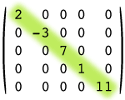
TYPES OF MATRICES:
SQUARE MATRIX
A square matrix is a matrix with the same number
Of rows and columns and the order of square is m*n
Where m=n
DIAGONAL MATRIX:
A diagonal matrix is a square matrix that has
values on the diagonal with all off-diagonal
values being zero

Slide 8

Cont.
SCALAR MATRIX:
A square matrix having same elements in its leading diagonal is called scalar matrix.
e.g.
$\left[\begin{aligned}a 0 0 \\ 0 a 0 \\ 0 0 a\end{aligned}\right] or \left[\begin{aligned}5 0 0 \\ 0 5 0 \\ 0 0 5\end{aligned}\right]$

Slide 9
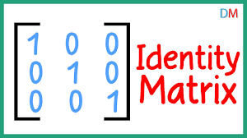
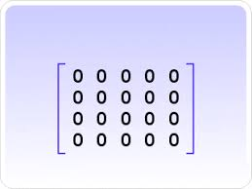
Cont.
IDENTITY MATRIX:
A scalar matrix having 1 in its diagonal is called
Identity matrix.
NULL MATRIX:
A null matrix is basically a matrix, whose all
elements are zero.

Slide 10
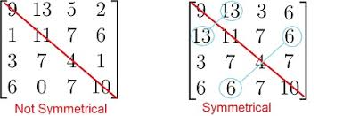
SYMMTERIC MATRIX
A matrix in which mirror image is same to
both sides of diagonal
Or
A symmetric matrix is a square matrix
that is equal to its transpose.

Slide 11
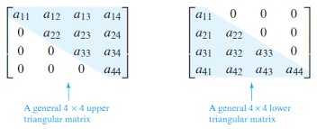
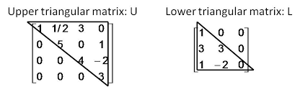
UPPER AND LOWER TRIANGULAR MATRIX
UPPER TRIANGULAR MATRIX
A matrix is called upper triangular matrix if all
the entries below the diagonal are zero
LOWER TRIANGULAR MATRIX
A matrix is called lower triangular matrix if all
the entries above the diagonal are zero

Slide 12

PROPERTY OF UPPER AND LOWER TRIANGULAR MATRIX
In any upper and lower triangular matrix, only multiply its diagonal elements to get its determinant.
e.g.
If A = $\left[\begin{aligned}2 5 7 \\ 0 4 6 \\ 0 0 3 \end{aligned}\right]$
Det(A) = 2$\left[\begin{aligned}4 6 \\ 0 3 \end{aligned}\right]$ - 5$\left[\begin{aligned}0 6 \\ 0 3 \end{aligned}\right]$ + 7$\left[\begin{aligned}0 4 \\ 0 0 \end{aligned}\right]$
Det(A) = 2(12-0) - 5(0-0) + 7(0-0)
Det(A)= 24
Using property!
For a diagonal, upper triangular and lower triangular matrix
Det(A) = product of diagonal elements.
Det(A) = 2*4*3
Det(A) = 24

Slide 13
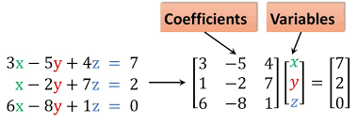

SYSTEM OF EQUATIONS & AUGMENTED MATRIX:
$\left[\begin{aligned}3 −5 4 7 \\ 1 −2 7 2 \\ 6 −8 1 0\end{aligned}\right]$
This is called an augmented matrix

Slide 14



SOLUTIONS TO LINEAR SYSTEM OF EQUATIONS: there must be 0, 1, ∞ solutions to any system of linear equation.
Unique Solution
No Solution
∞ Solutions
$$\left[\begin{aligned}1 0 0 6 \\ 0 1 0 3 \\ 0 0 1 4\end{aligned}\right]$$
Here
X = 6, Y = 3, Z = 4
$$\left[\begin{aligned}1 0 0 1 \\ 0 1 0 3 \\ 0 0 0 8\end{aligned}\right]$$
$$\left[\begin{aligned}1 0 3 1 \\ 0 1 2 3 \\ 0 0 0 0\end{aligned}\right]$$

Slide 15
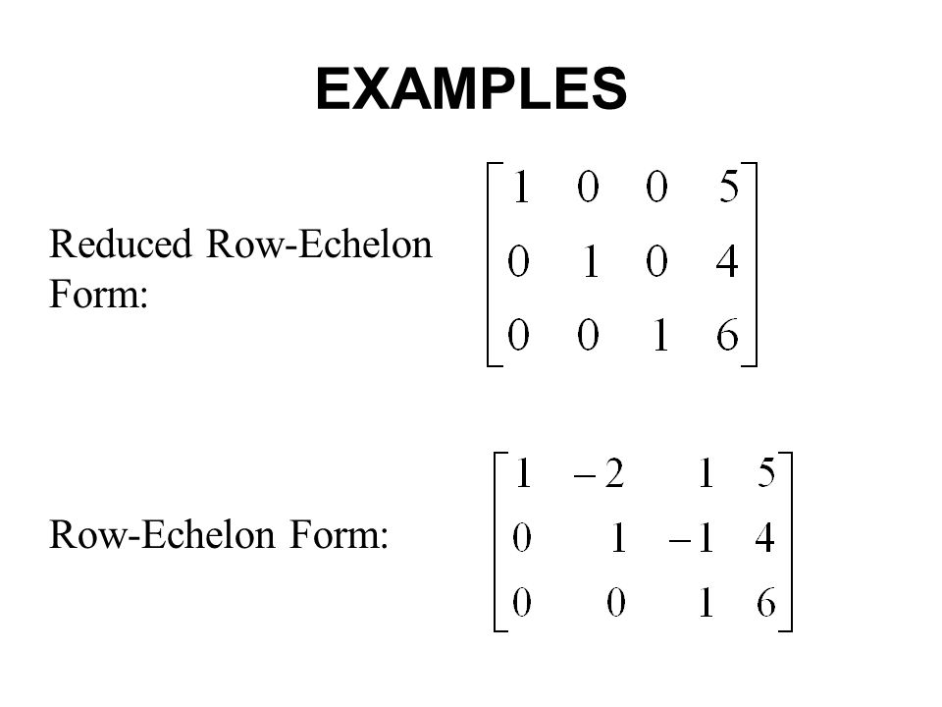
ECHELON AND REDUCED ROW ECHELON FORM

Slide 16
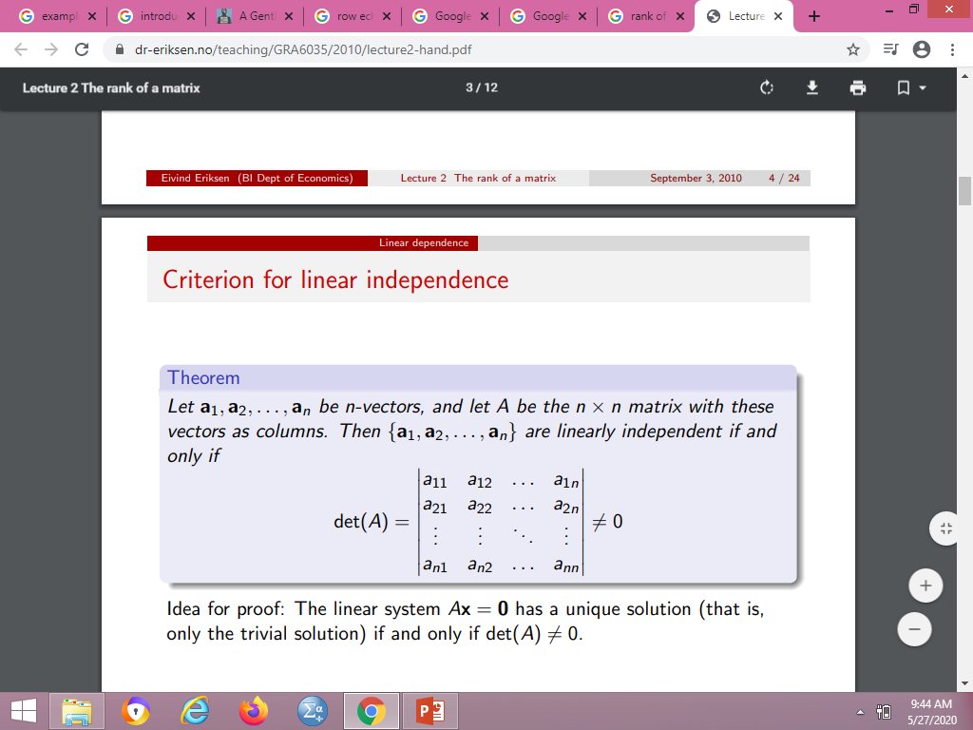
LINEAR INDEPENDENCE OF VECTORS

Slide 17
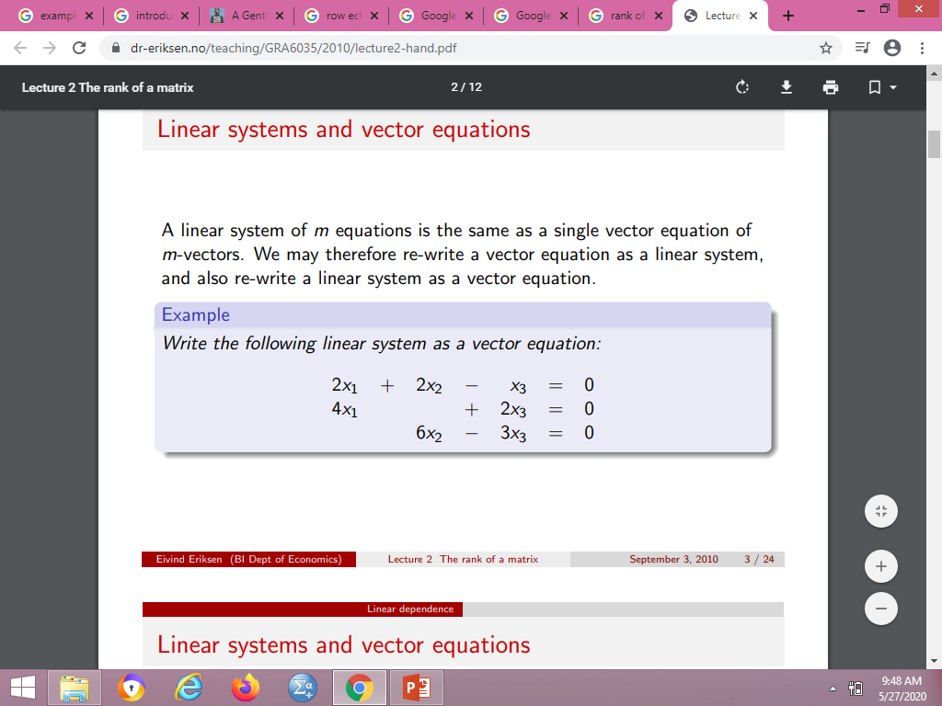
Q: Write down the given system of equations in vector form then prove that these vectors are linearly independent

Slide 18
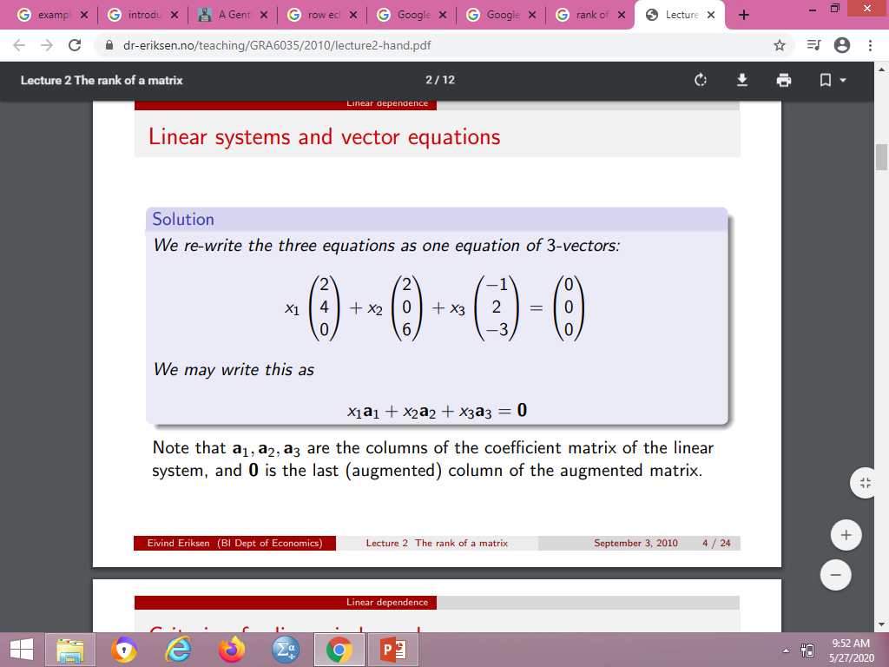
SYSTEM OF EQUATION TO VECTORS

Slide 19
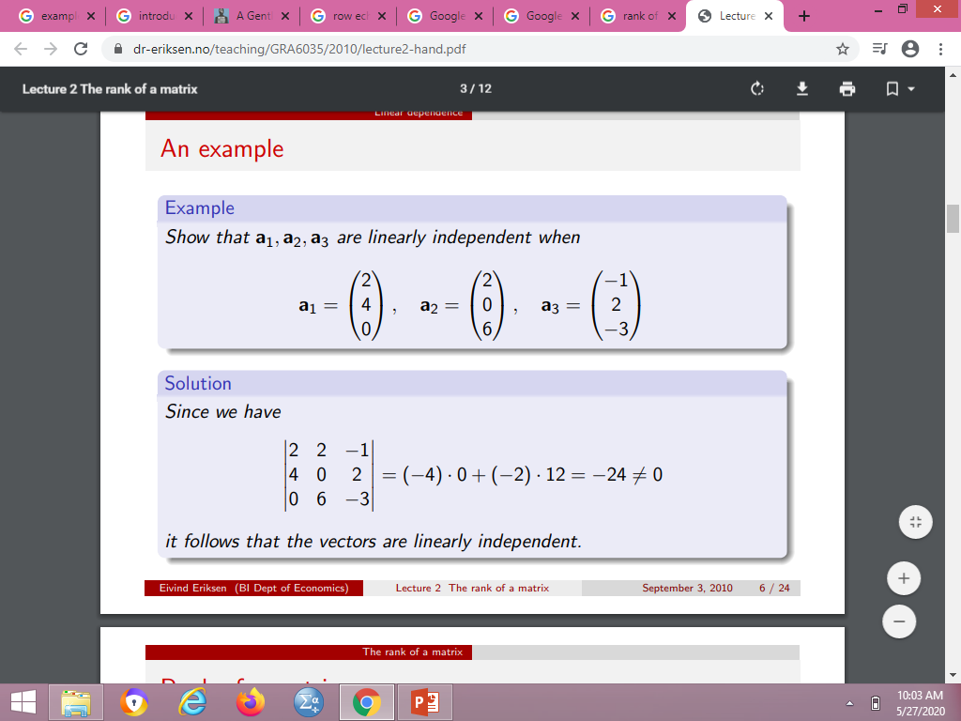
Now we have to show that these vectors are linearly independent.

